Slide 1
SS ZG 526: Distributed Computing
Peer-to-Peer Networks
Chittaranjan Hota
Professor, Dept. of Computer Sc. & Information Systems
BITS, Pilani Hyderabad Campus, Hyderabad
hota@hyderabad.bits-pilani.ac.in

Slide 2



What is a Peer?
Contrast with Client-Server model
Servers are centrally maintained and administered
Client has fewer resources than a server
Birla Institute of Technology and Science, Pilani (Deemed University)

Slide 3

What is a P2P Overlay?
Selfish objective
C
E
F
P2P overlay layer
A
H
D
G
B
A
C
E
F
H
AS₁
AS₄
B
AS₆
AS₂
D
Native IP layer
AS₅
Improved services
AS₃
G
Birla Institute of Technology and Science, Pilani (Deemed University)

Slide 4

Latency optimized Overlay: an example
  Overlay routing is independent of native layer routing
  Each Overlay path comprises one or more Overlay links, based on a selfish objective
A
50ms
D
20ms
20ms
B
C
Birla Institute of Technology and Science, Pilani (Deemed University)

Slide 5

Characteristics and Performance features
  Distributed Control
    Fast search for machines and data objects
  Efficient use of resources
  Self-organizing
    All peers organize themselves into an application layer network on top of IP.
  Scalability
    Consumers of resources also donate resources
    Aggregate resources grow naturally with utilization
  Reliability
    No single point of failure
    Redundant overlay links between the peers
    Redundant data source
  Ease of deployment and administration
    Built-in fault tolerance using replication, and load balancing
    No need of any change in the underlying IP networks
Birla Institute of Technology and Science, Pilani (Deemed University)

Slide 6

Generic P2P Architecture
Search API
Content Storage
Overlay Messaging API
Routing and Forwarding
Neighbor Discovery
Join/Leave
Bootstrap
Peer Role Selection
Capability &
Configuration
NAT/ Firewall Traversal
Operating System
Birla Institute of Technology and Science, Pilani (Deemed University)

Slide 7

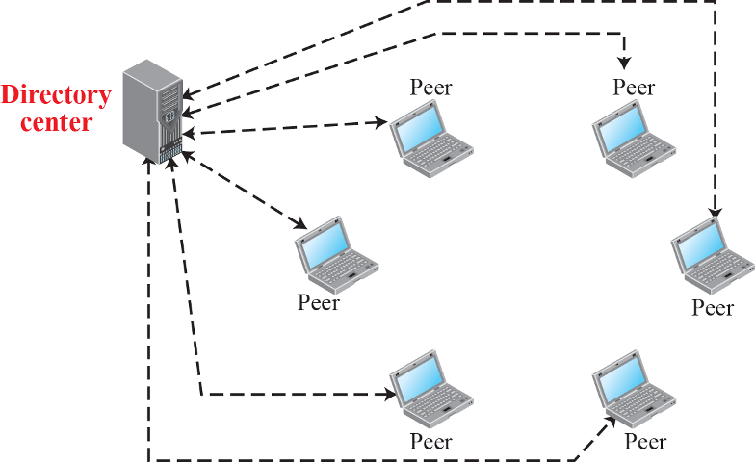







Centralized P2P Networks
Source: MGH
Birla Institute of Technology and Science, Pilani (Deemed University)

Slide 8
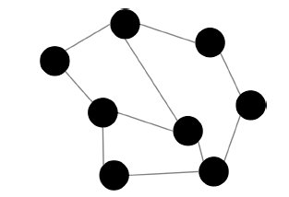

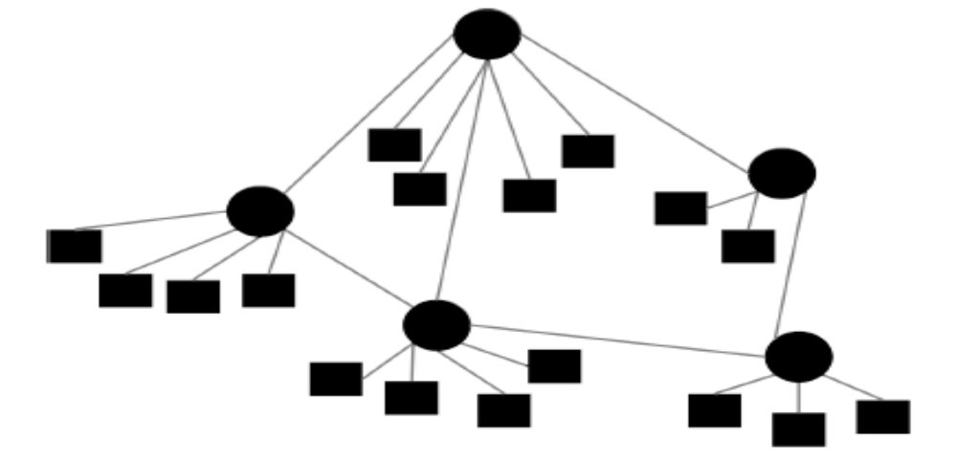
Decentralized P2P Architectures
Purely Decentralized
Partially Decentralized
Birla Institute of Technology and Science, Pilani (Deemed University)

Slide 9

Applications over P2P
Application Purpose | Purely Decentralized | Partially Decentralized | Hybrid Decentralized
Content Publishing & Storage | Freenet, PAST, OceanStore, CFS [Dabek et al. 2001]
File Sharing | Gnutella, Free Haven | Gnutella 0.6 [Gnutella 2002], Kazaa | Napster, BitTorrent
Anonymous Storage | Freenet
Communication & Messaging | Groove, SharedMind | Skype | Jabber
Backup operations | Pastiche
Infrastructure base | Chord [Stoica et al. 2001], Pastry [Rowstron and Druschel 2000], Tapestry[Zhao et al. 2003], CAN [Ratnasamy et al. 2001]
Routing | RON [Andersen et al. 2001]
Search engines | Minerva [Michel et al. 2005], ODISSEA [Suel et al. 2003]
Computation |  |  | SETI@home
Web Caching | Squirrel
Multicasting | Split Stream [Castro et al. 2003], Scribe, Bayeux[Zhuang et al. 2001]
Spam filtering | SpamWatch[Zhou et al. 2003]
Domain name lookup | DNS using Chord [Cox 2002]
Multimedia Streaming | PPLive, Coolstreaming
Intrusion Detection | Indra [Janakiraman et al. 2003]

Slide 10

Commercial Applications over P2P
Application | Purpose | Company | Since
Kontiki | Hybrid peer-to-peer content distribution targeting media content | M K Capital | 2008
Skype | Voice over peer-to-peer | eBay | 2006
Groove | Collaboration without any help of central server. Known customers: Dell, Department of Defense, GlaxoSmithKline and Veridian | Groove Networks | 2001
Magi | P2P infrastructure platform for building secure, cross-platform, collaborative applications | Endeavours Technologies | 2001
Zattoo | Streaming to TV viewers over internet | Zattoo | 2006
CoolStreaming | To share television content using swarms | Roxbeam Corp. | 2005
PPTV | Live and on-demand TV service over internet | PPLive | 2005
Joost | Streaming legal videos in agreement with publishers | Adconion Media Group | 2009
Birla Institute of Technology and Science, Pilani (Deemed University)

Slide 11
Next Session
Design of Un-structured Peer to Peer Networks
Birla Institute of Technology and Science, Pilani (Deemed University)

